Slide 1
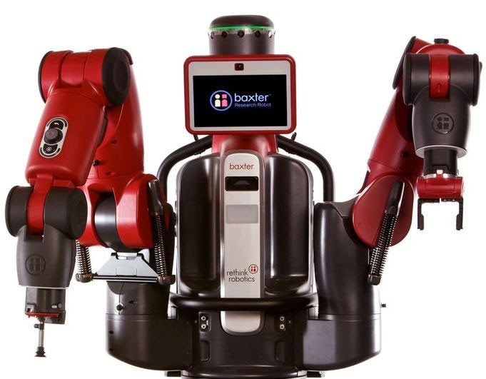
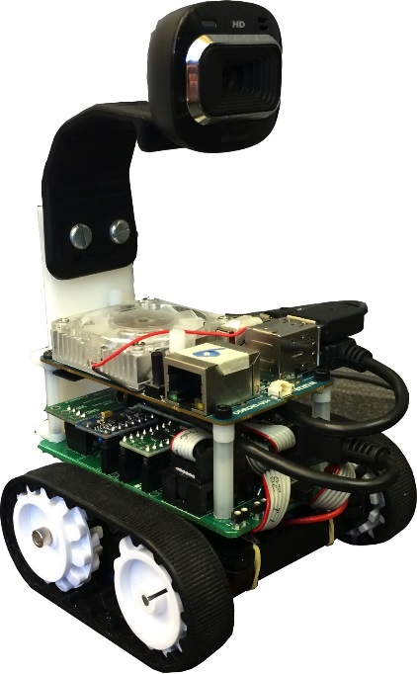
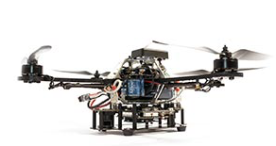
EE 106A/206A Introduction to Robotics Fall 2018
Ruzena Bajcsy
GSIs:
Valmik Prabhu, Nandita Iyer, Ravi Pandya, Brent Yi, Phil Wu, +

Slide 2
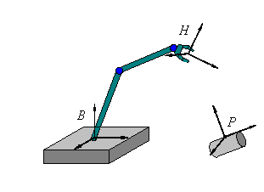
Preamble
Most slides in this course have benefited from:
previous lectures prepared by Vincent Duindam, Edgar Lobaton, Ram Vasudevan
notes from Zexiang Li and Yuanqing Wu, based on the textbook A Mathematical Introduction to Robotic Manipulation by R. Murray, Z. Li and S.S. Sastry (available online via bCourses).
The current version of these slides is by R. Bajcsy.

Slide 3
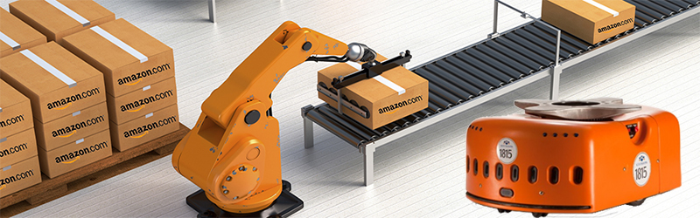
Course logistics
All lectures and course materials will be posted on bCourses (discussions will be on Piazza).
Homeworks will help you internalize the concepts covered in class.
Labs will allow you to apply techniques on real robots.
There will be two midterms:
Midterm 1: September 27th (review on September 25th)
Midterm 2: November 8th (review on November 6th)
There is a final project instead of a final exam.

Slide 4
IMPORTANT: FILL OUT ASAP
Google form on preferred lab sections & experience
Webacct form to gain lab computer access
Both are linked on the syllabus, the front page of the bCourses website, and a bCourses announcement you should have received.

Slide 5
Contact Info
valmik@berkeley.edu
brenty@berkeley.edu
nandita@berkeley.edu
rpandya922@berkeley.edu
phil80301@berkeley.edu
bajcsy@eecs.berkeley.edu
For a timely response, use Piazza.

Slide 6
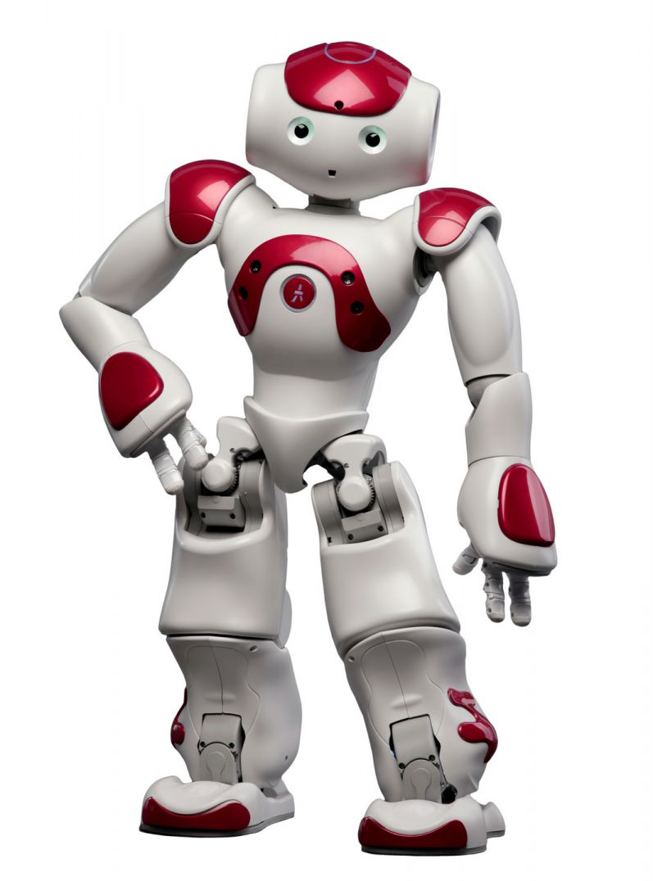
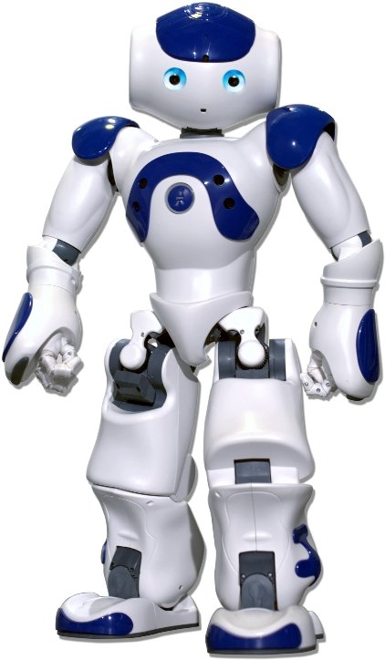
Course grade
20% for N homeworks
Each homework is posted on Friday on bCourses and is due the following Thursday at 11:59pm*.
20% for 8 labs
Each lab is completed with a partner and needs to be checked off by a GSI by the end of your section*.
20% for 2 midterms (10% each)
40% for the final project
*See course syllabus for details
on lab and homework policy.

Slide 7

Prerequisites for this course
Knowledge of linear algebra
Programming in Python (for labs and homeworks)
Curiosity about how things work
Interest in experimental work
Willingness to explore

Slide 8
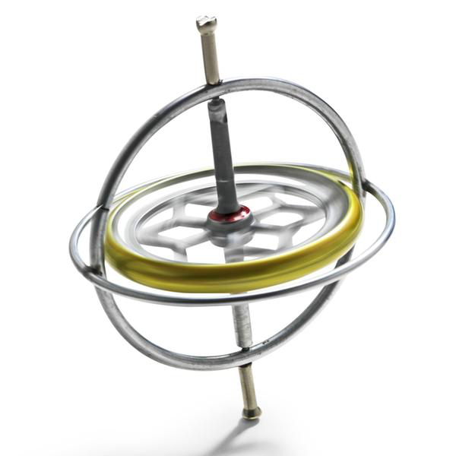
Lectures
Lecture 0: Organization of the course and introduction to Robotics as a field
Lecture 1: Principles of rigid body motion
Lecture 2: Rotational motion
Lecture 3: Homogeneous coordinates
Lecture 4: Exponential coordinates, velocities and twists

Slide 9
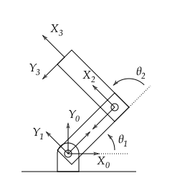
Lectures
Lecture 5: Forward kinematics
Lecture 6: Inverse kinematics
Lecture 7: Computer vision for robotics
Lecture 8: More Vision

Slide 10
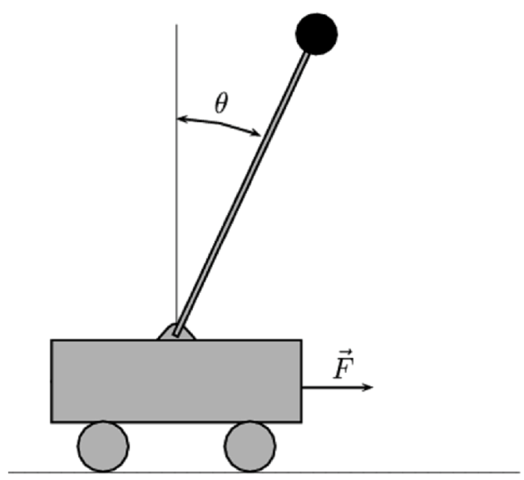
Lectures
Lecture 9: Review
Lecture 10: Midterm I
Lecture 11: Rigid body velocities
Lecture 12: Jacobians
Lecture 13: Forces and wrenches
Lecture 14: Masses and moments of inertia
Lecture 15: Newtonian dynamics
Lecture 16: Lagrangian dynamics

Slide 11
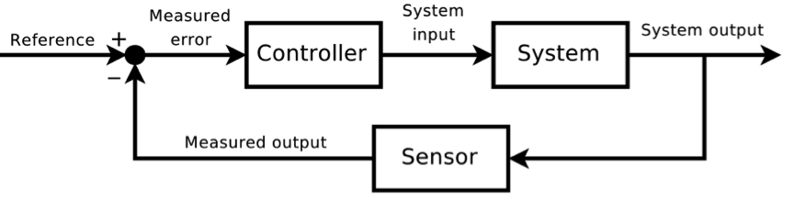
Lectures
Lecture 17: Feedback control
Lecture 18: State estimation
Lecture 19: Parameter identification
Lecture 20: Contact sensors
Lecture 21: Review
Lecture 22: Midterm II

Slide 12
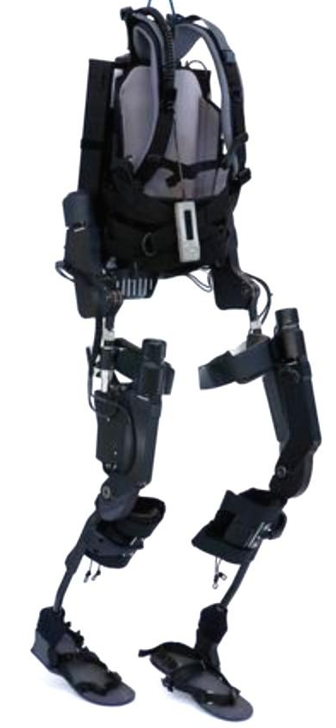
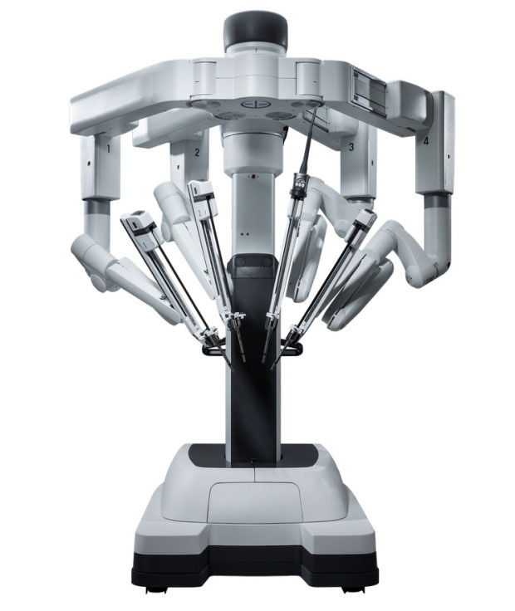
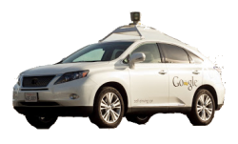
Lectures
Lecture 23: Systems testing / Lyapunov
Lecture 24: Results validation / Lyapunov
Lecture 25: Special topics / robot PID
Lecture 26: Holiday
Lecture 27: Special topics
Lecture 28: Special topics / guest lecture

Slide 13
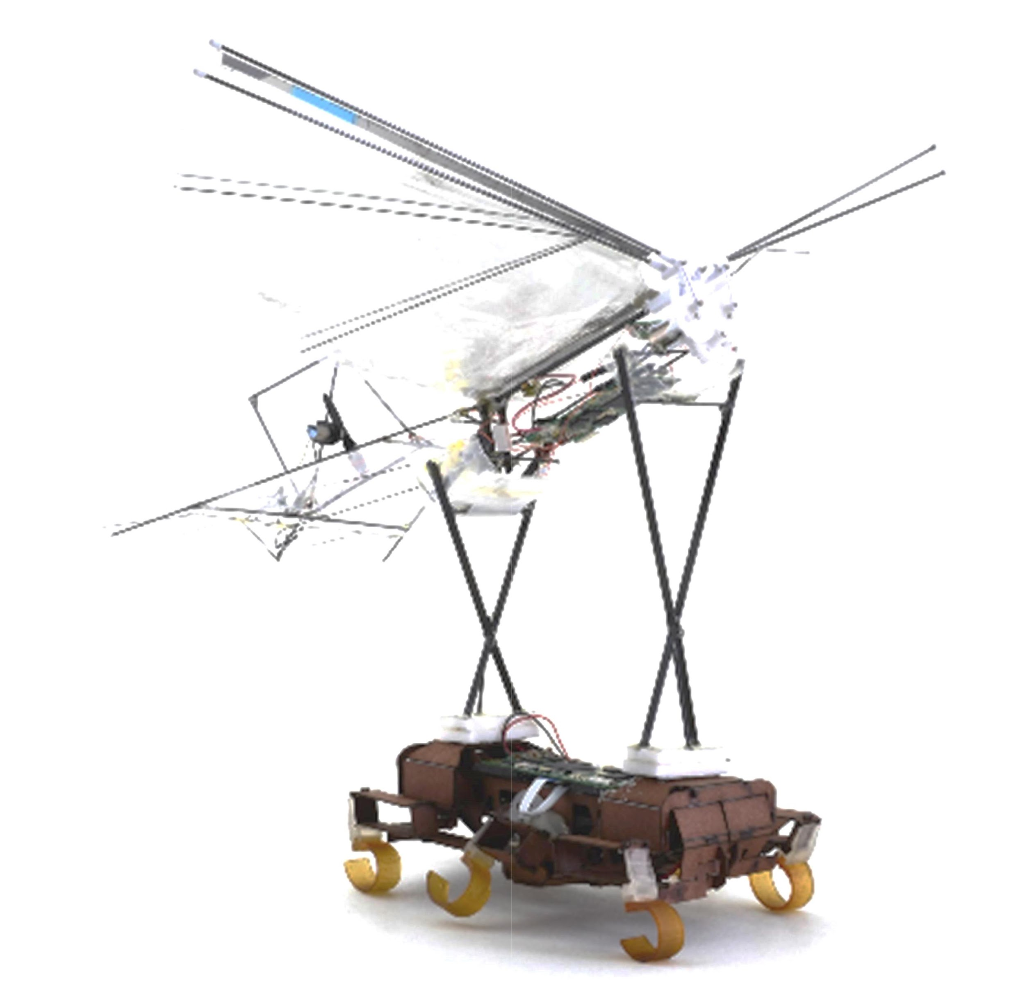
Discussion and lab sections
Lab
LAB 101 M 9a-12p Nandita Iyer 111 Cory
LAB 102 M 12-3p Valmik Prabhu 111 Cory
LAB 103 M 3-6p Nandita Iyer 111 Cory
LAB 104 W 9a-12p Nandita Iyer 111 Cory
LAB 105 W 12-3p Ravi Pandya 111 Cory
LAB 106 W 3-6p Valmik Prabhu 111 Cory
LAB 107 F 9a-12p Ravi Pandya 111 Cory
LAB 108 Tu 11a-2p Phillip Wu 111 Cory
LAB 109 Tu 5-8p Phillip Wu 111 Cory
Discussion
DIS 201 F 12-1p Brent Yi 293 Cory
DIS 202 F 1-2p Brent Yi 293 Cory
DIS 203 F 2-3p Brent Yi 293 Cory
DIS 204 F 3-4p Brent Yi 293 Cory
DIS 205 W 9-10a Brent Yi TBA Cory
DIS 206 Th 5-6p Brent Yi TBA Cory

Slide 14

Labs
Lab 1: ROS tutorials I
Lab 2: ROS tutorials II
Lab 3-4:
Forward kinematics with Baxter/Sawyer
Camera calibration and range finding
After Labs 1-2, each lab section will be split in half. Each group will work with Baxter/Sawyer every other week, while the other works with the TurtleBots.

Slide 15
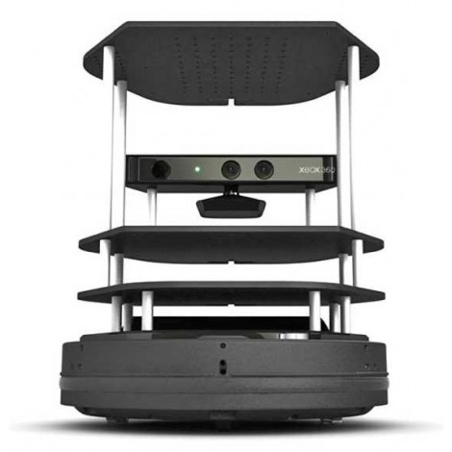
Labs
Lab 5-6:
Inverse kinematics, pick and place with Baxter/Sawyer
Path planning with TurtleBots
Lab 7-8:
Path planning with Baxter/Sawyer
SLAM / Kalman filter tracking with TurtleBots
See course syllabus for details on lab requirements.

Slide 16
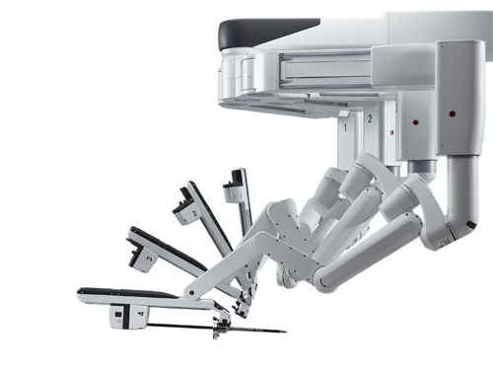
Office Hours
Prof. Bajcsy Office Hours
By Appointment, 719 Sutardja Dai Hall
GSI Office Hours (Valmik Prabhu)
Wednesday 6-7, Thursday 5-6 111 Cory Hall

Slide 17
Project guidelines
Projects are expected to apply multiple aspects of what you have learned
Every project should include some sensing, planning and manipulation.
Demonstrate good designer/experimentalist rigor:
What did you measure, what are your assumptions, what did you compute from the measurements?
How did you evaluate your results (systematic errors, random errors)?
Lessons learned. What should be the next steps?
See course syllabus for details on project requirements.

Slide 18
Project timeline
Project ideas –––––––––––––– (mid-September)
Possible topics to work on
We’ll send you written feedback
Project proposals –––––––––– (mid-October)
Context, goals and approach
Include Bill Of Materials
We’ll meet to review it with you
Project kickoff ––––––––––––– (mid-October)
Project milestones –––––––––– (TBD)
Project deadlines:
TBD (demos) TBD (website)

Slide 19

Questions

